Slide 1
Welcome to all
for the MHRM Online lecture
By
Mr. Dhiraj Ovhal
HOD of Commerce

Slide 2
Chapter -3
Marketing Decision –II
(Place and Promotion)

Slide 3
Meaning and Definition of Marketing Mix?
Meaning:- Marketing mix means of Combination of
“4 Ps” i.e. Product, Price, Place & Promotion
Definition:- In 1960, E. Jerome McCarthy defines
“The basis of Marketing operations is the co-ordination of four key variables, namely : Product, Price, Place and Promotion”.
( Way to remember :- -co-ordination of four key variables, )

Slide 4
Q.3 Recent trends in Channel of distribution / Contemporary distribution channel/ New/Modern methods of Channel of distribution
Way to remember: - HM2 T Vatch

Slide 5
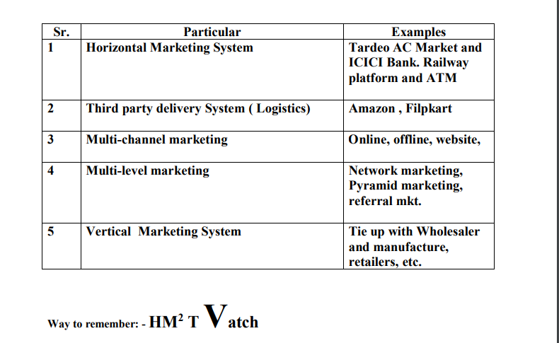

Slide 6
1. Horizontal Marketing System (HMS):
A horizontal marketing system is a distribution channel arrangement whereby two or more firms at the same level together for marketing purposes to capitalizing system is a distribution channel
opportunity.
The firms combine their resources such as such as production capabilities and distribution in order to maximize their earnings potential.
The Firms can work together on a temporary or permanent or create a joint venture.
Examples:
A bank and a supermarket agree to have the bank's ATMs located at the supermarket's locations.
Two manufacturers combining to achieve economies of scale, otherwise not possible with each acting alone, in meeting the needs and demands of a very large retailer.
Two wholesalers joining together to serve a particular region at a certain time of year.

Slide 7
Third Party Delivery Channel:
A third-party logistics (3PL) provider is a firm that provides service to its clients of outsourced logistics services for part, or all of their supply chain management functions.
Third party logistics providers typically specialize in integrated operations - warehousing, inventory management, logistical packaging and transportation services that can be customized to needs of the clients.
The services are customized to the clients based on market conditions and the demands and delivery service requirements for their products and materials. There are also 3PL providers who may specialize in only one or two areas of logistics - warehousing, or transportation or inventory management on material handling.

Slide 8
3. Multi-Channel Marketing:
Multi-channel marketing uses different marketing channels to reach a customer. A channel might be an online store and an offline store. It may also offer direct marketing service to the customers directly with the help of its sales-force at the doorstep of the customer.
Multi-channel marketers may communicate with the customer direct and indirect communication channels such as websites, mail order catalogs, direct mail, email, mo and outdoor advertising, publicity, and so on.

Slide 9
4. Multi-level marketing (MLM)
It is a marketing strategy in which the sales force is compensated not only for sales they personally generate, but also for the sales of the other salespeople that they recruit. Other terms used for MLM include pyramid selling, network marketing, and referral marketing.
Most commonly, the salespeople are expected to sell products directly to consumers by means of relationship referrals and word of mouth marketing.
Some of the top MLM marketing companies operating in India include:
Avon - is New York based multi level marketing company established in year 1886. It is a direct marketing company which sells cosmetic, beauty and personal products.
Hindustan Unilever Ltd. -is a subsidiary of Anglo-Dutch Unilever. Unilever is a cosmetic and consumer products manufacturer which was founded in the year 1930. It subsidiary in India (HUL) is a leading FMCG which offers MLM in the cosmetic product category.

Slide 10
Tupperware-established in 1942 is a Orlando (USA) based multi level marketing company which offers wide range of products such as kitchen, home appliances and food products. It offers direct marketing opportunity without any major investment required.
Amway - a USA based multinational and direct marketing company. Amway was established in year 1959 and has global footprints in more than 100 countries.

Slide 11
5.Vertical Marketing Systems:
In some instances, the efficiency of the distribution channel is disrupted because of conflicts among channel members. Conflict can occur between manufacturers and wholesalers as well as between the producers and the retailers. For instance, conflicts may occur due to delay in supplies, especially during festive seasons, on account of incentives' package, and so on.
In USA, one firm did not supply high tech toys for pre-Christma sale. As a result of this the retailers not only lost sales but als were left holding large inventories of toys after the Christma season was over.
Efforts to reduce conflict and improve the efficiency of th distribution channels resulted in the development of vertical marketing system (VMS). place when two or mo stages of a distribution channel are combined and managed one firm. VMS has become a popular method of organizing distribution channel. There are three types of VMS - administer VMS, Contractual VMS, and Corporate VMS.

Slide 13
Thank You

Slide 14
Attendance Link
https://forms.gle/Xqvykv5vfEi1zpyF7
(Mention date at last point)

